Slide 1
Chinook Data Analysis By: Zahra Mahmoodabadi

Slide 2
agenda
Introduction
An Initial study on chinook data
Key variables plot
Normal variables in data
Remove outliers data
Hypothesis tests
confidence interval

Slide 3

Introduction

Slide 4
Introduction
A sample database designed for a digital media store.
Data Model: Represents a digital media store with tables for: Artists, Albums, Media Tracks, Invoices, Customers

Slide 5
An Initial study on chinook data
How many records each table has
Remove Duplicate data,
Manage Missing Values

Slide 6
Selecting Key variables

Slide 7
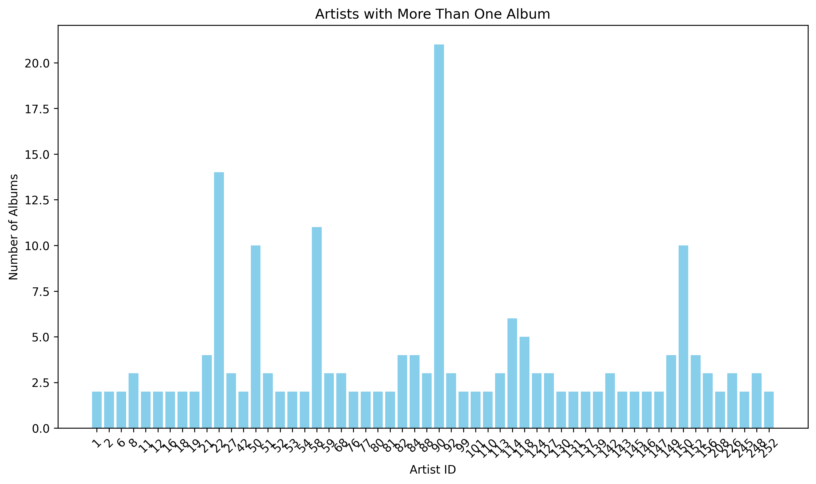
Artists
Total Artists: 275
150 of 275 artists had just 1 album

Slide 8
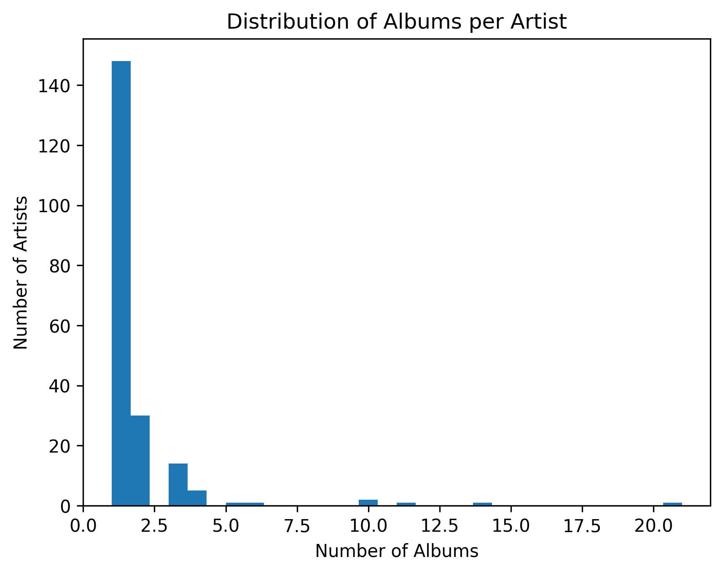
Albums per artist
Total Albums: 347

Slide 9
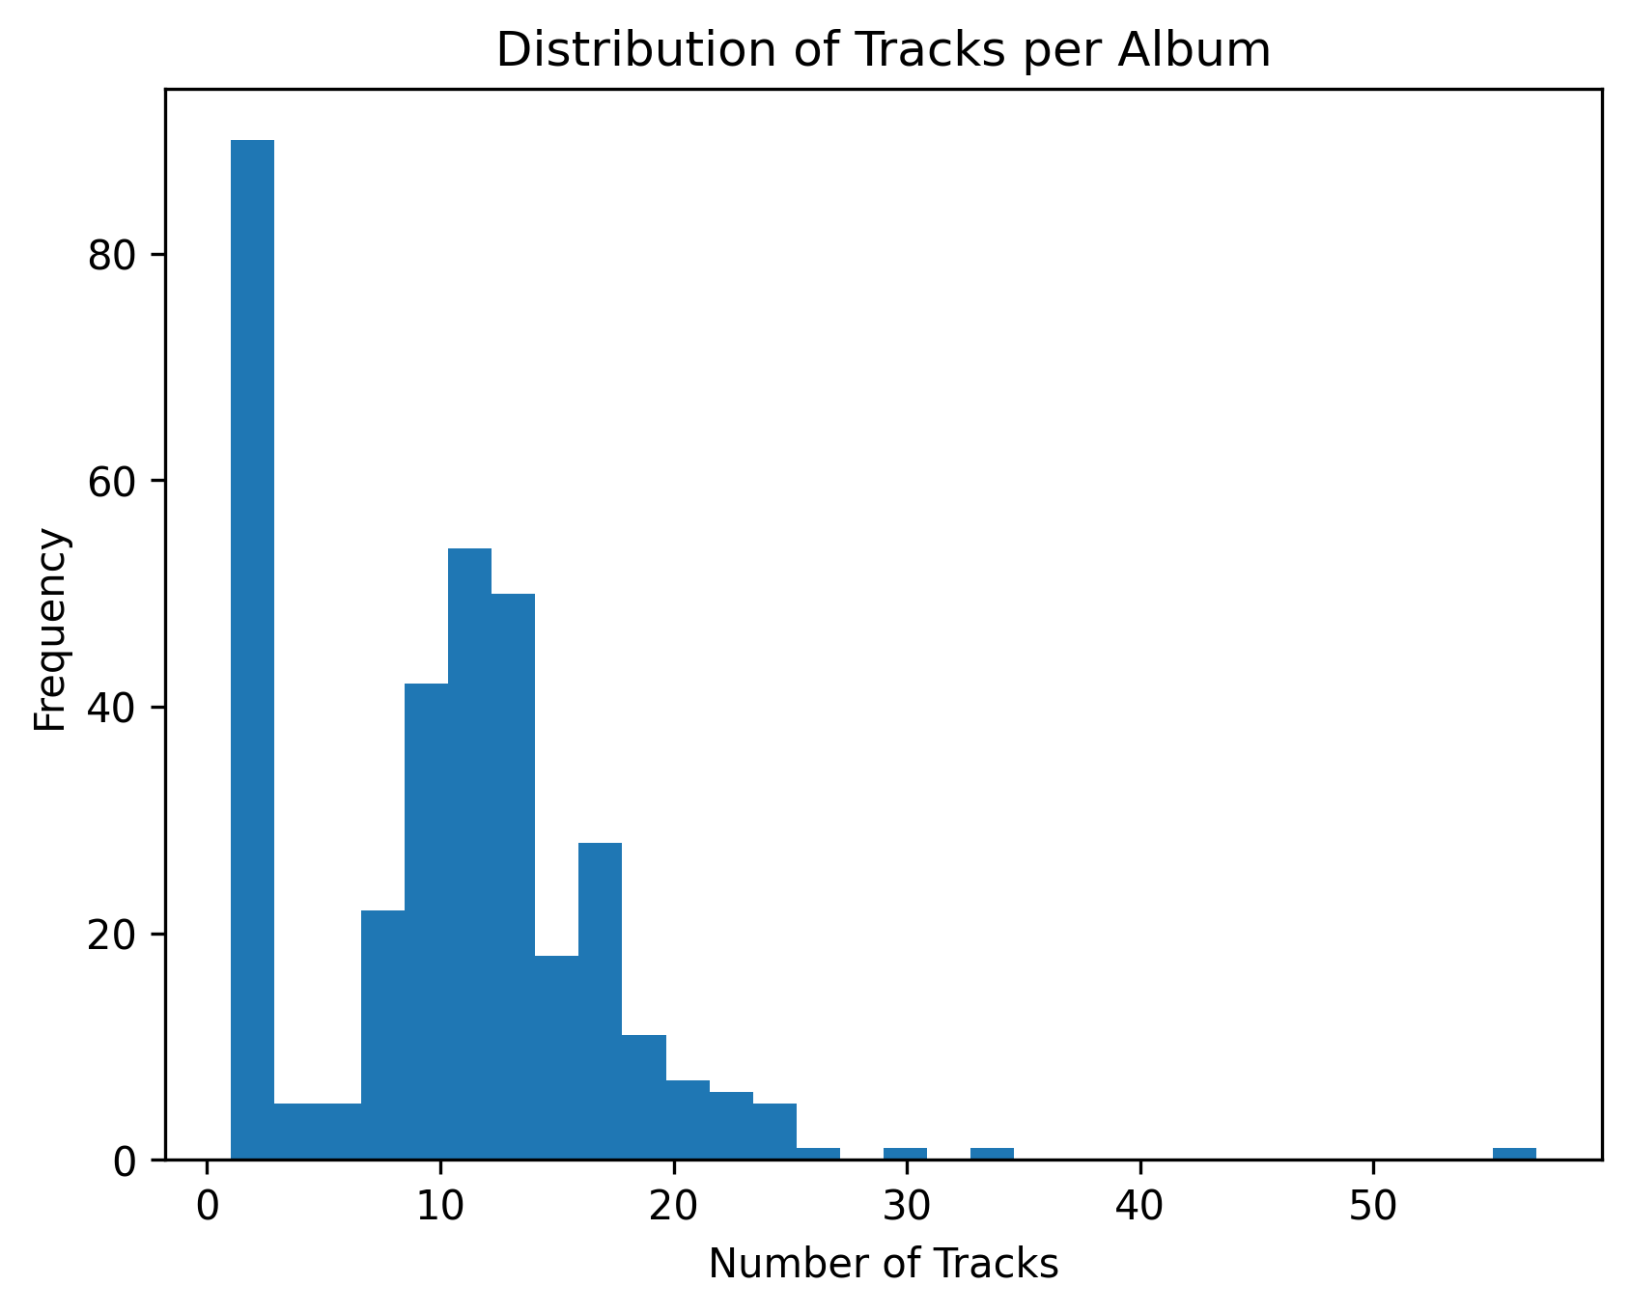
Distribution of tracks by album
Total Tracks: 3503
For example there are more than 80 albums that have just 1 track.

Slide 10
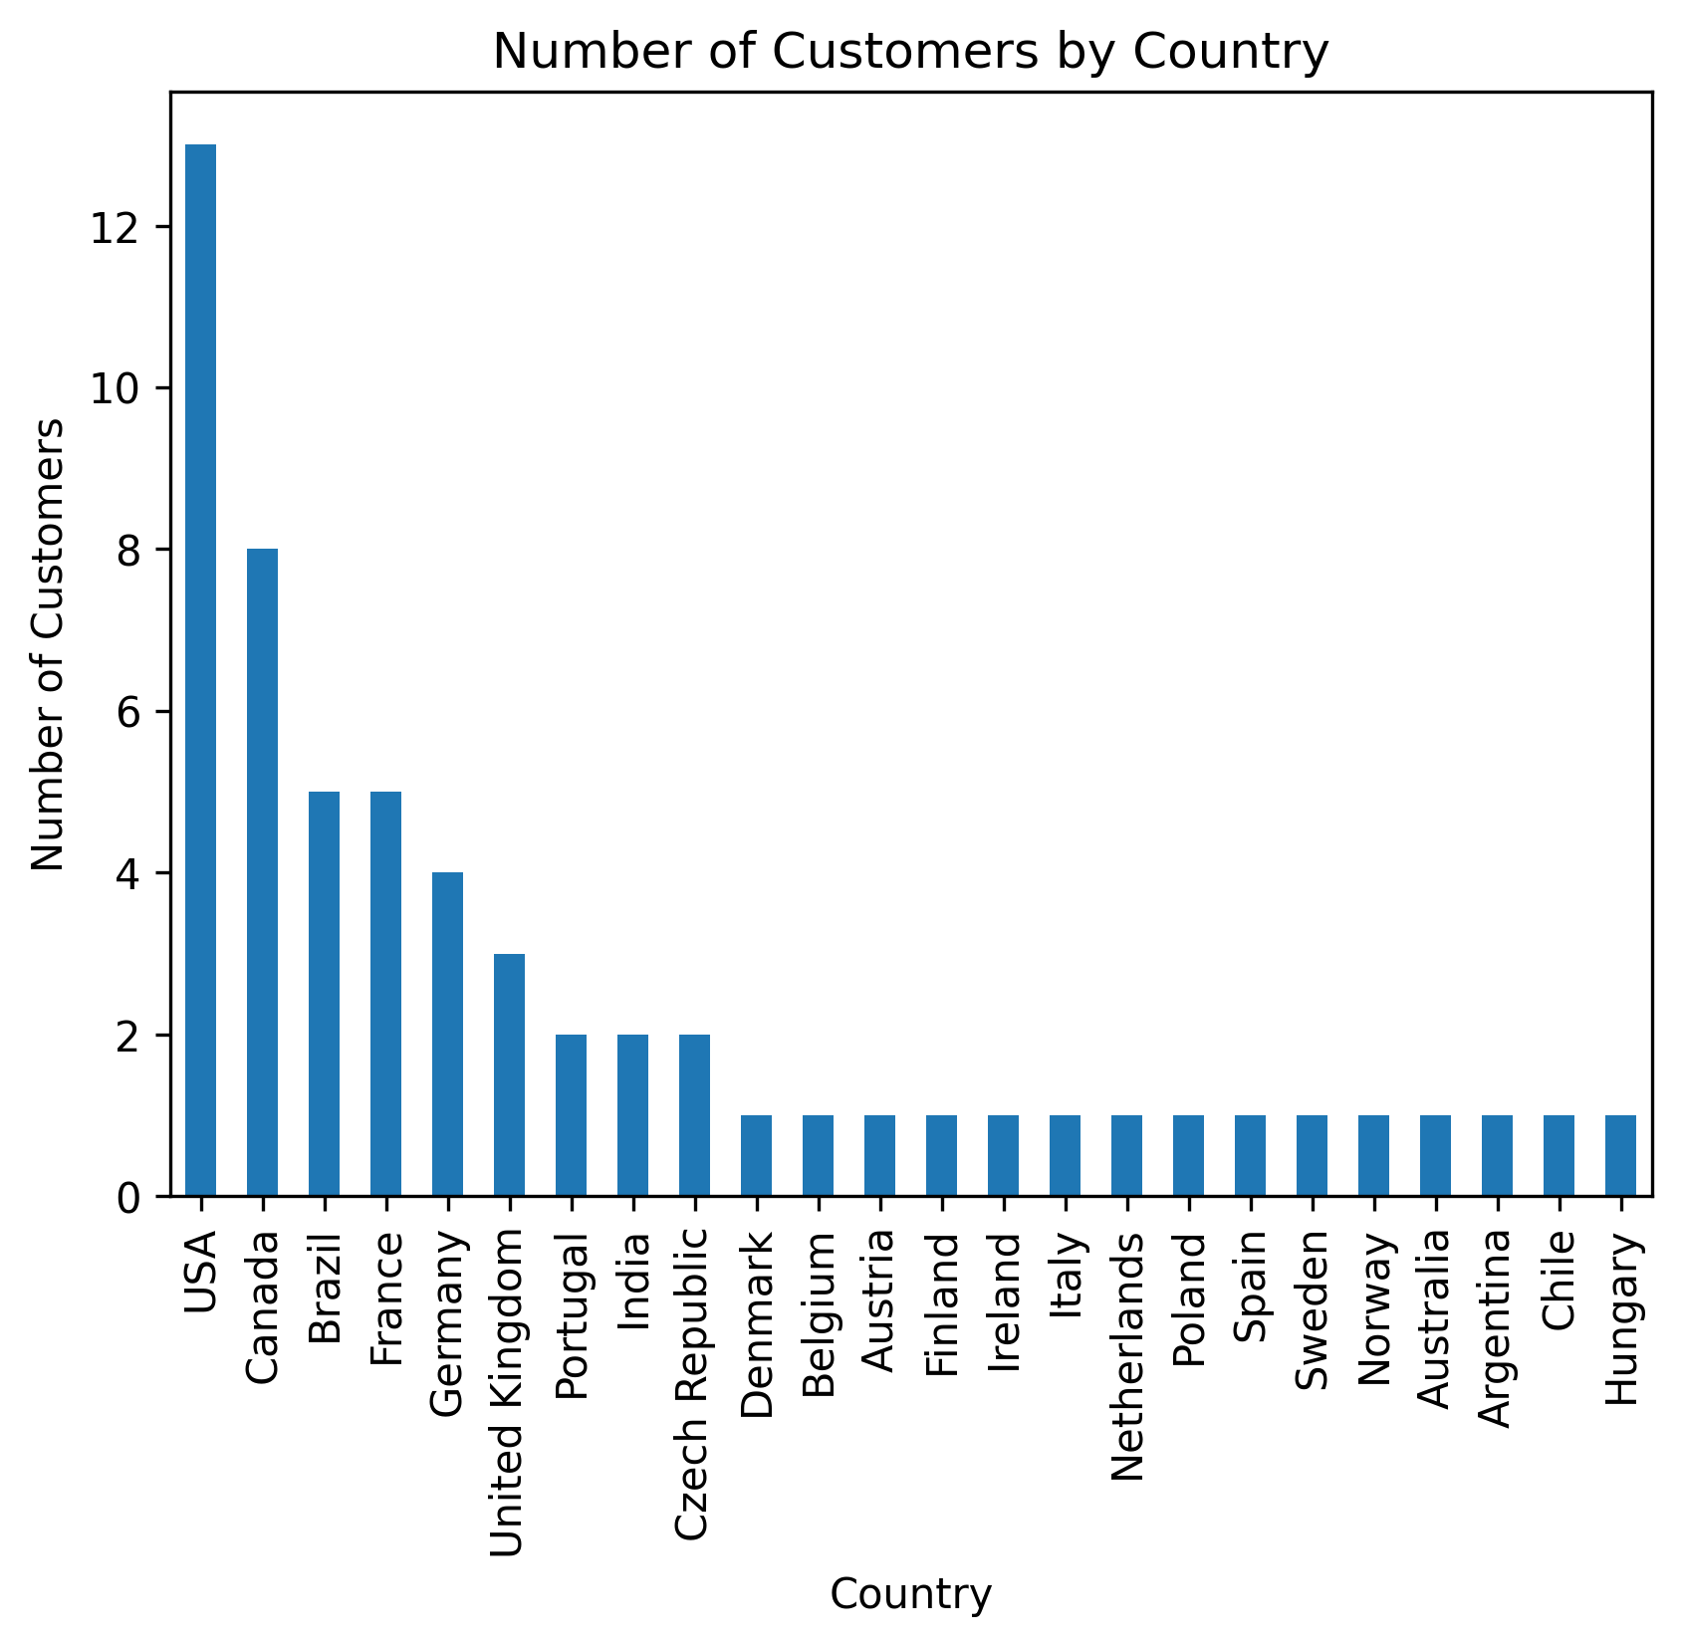
distribution of customers by countries
Total Customers: 59
More than 12 of 59 customers are from USA

Slide 11
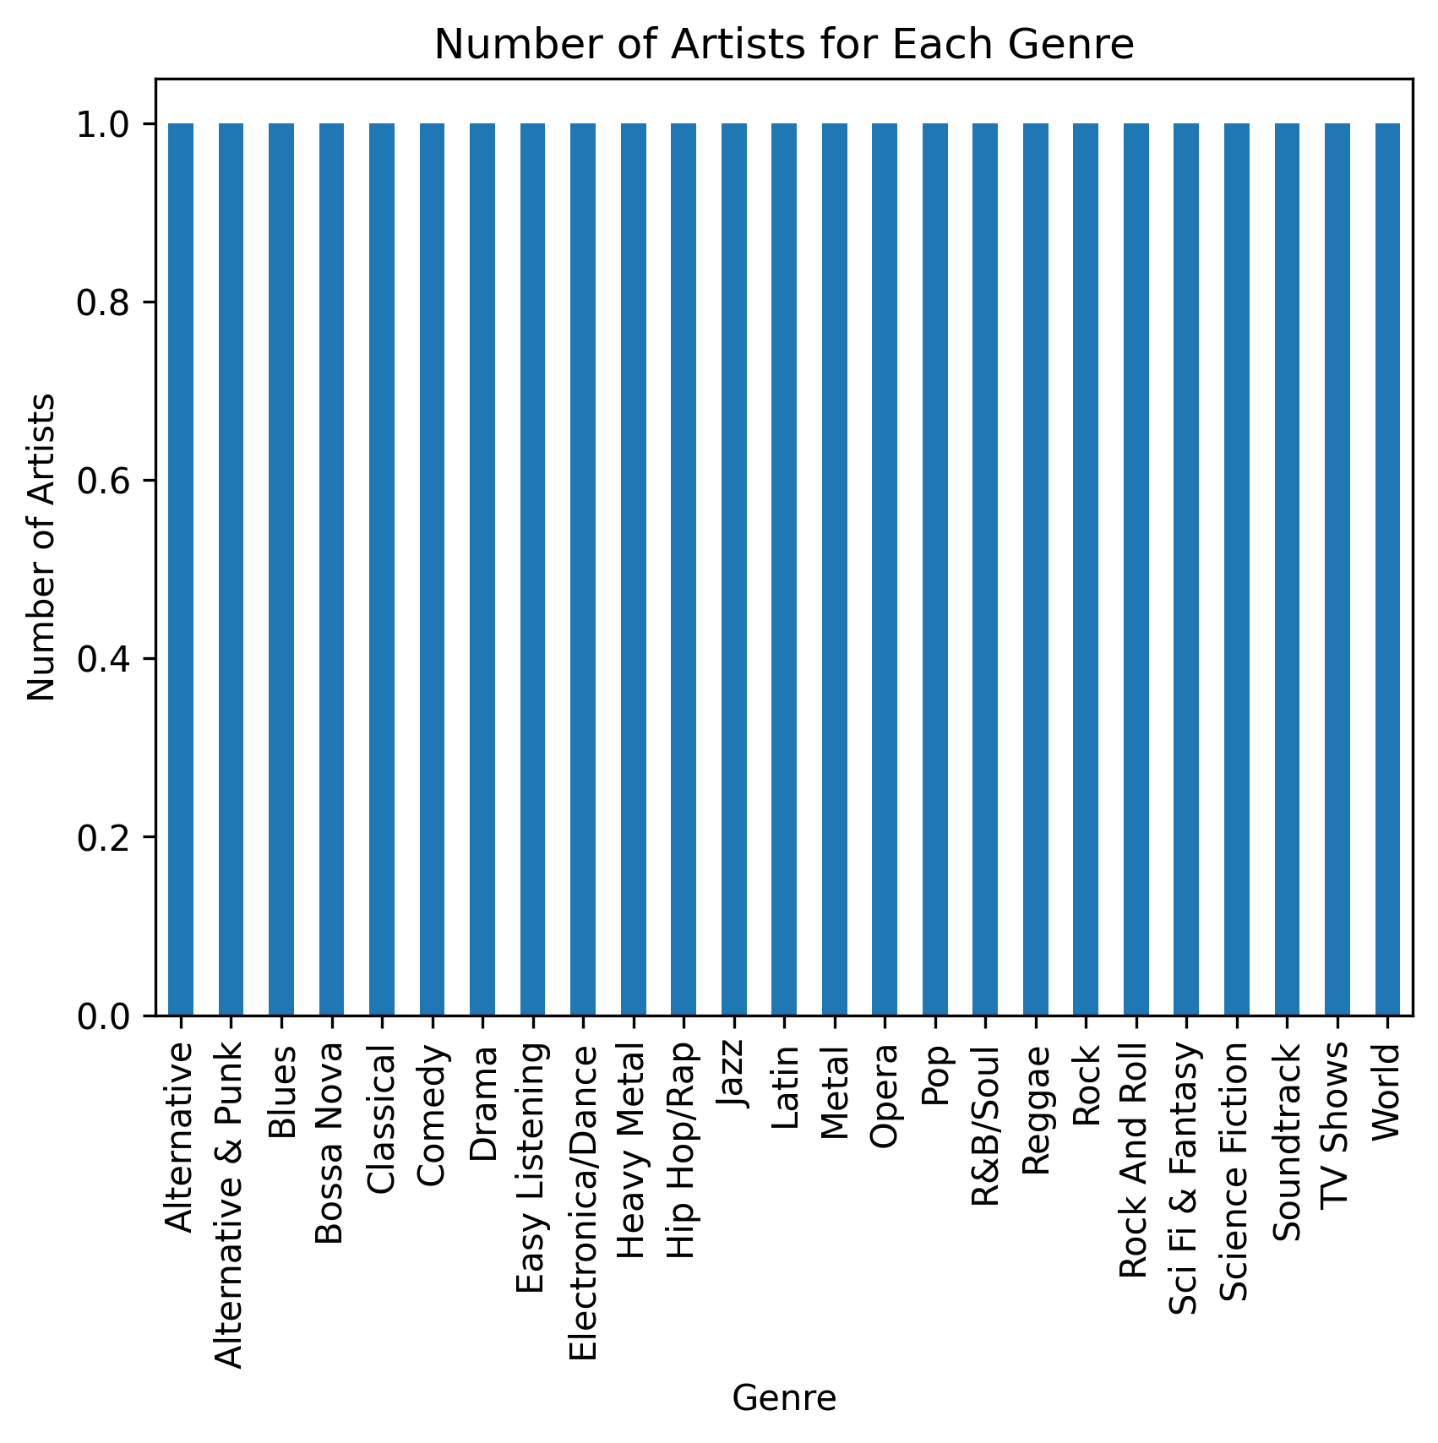
Number of artists based on genre
Which genres the highest number of artists
There is only 1 artist for each genre

Slide 12
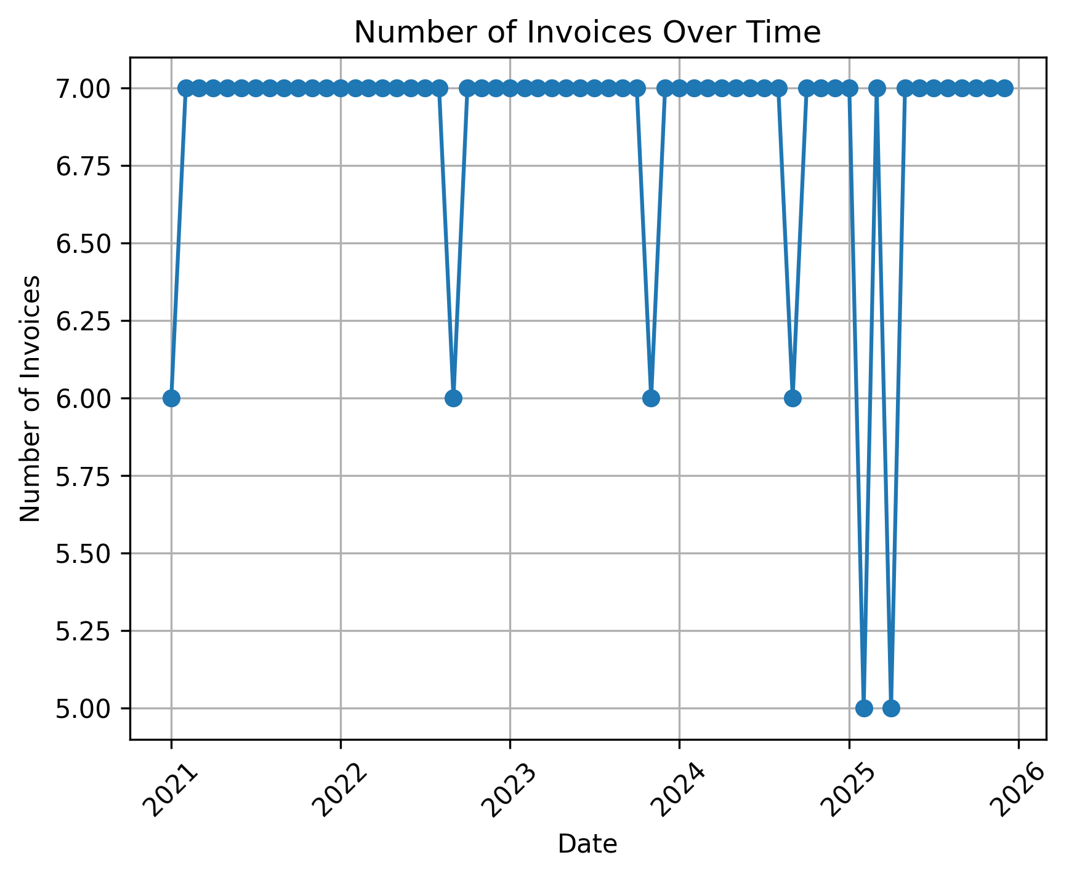
Number of Invoices Over Time
Show changes in the number of invoices over time
In the first month of the years there are minimum orders for musics

Slide 13
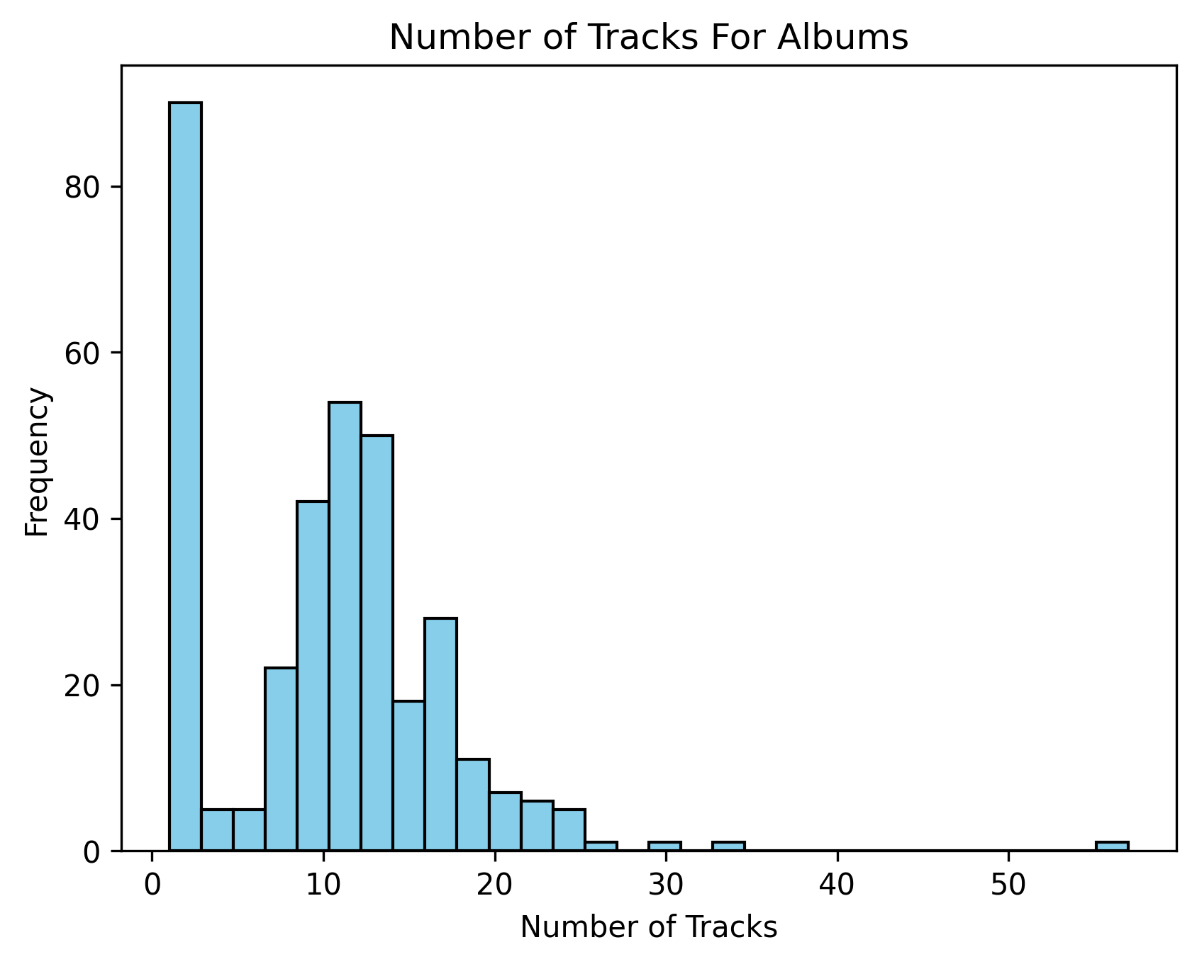
Number of Tracks for each Album
More than 80 albums have just 1 track

Slide 14
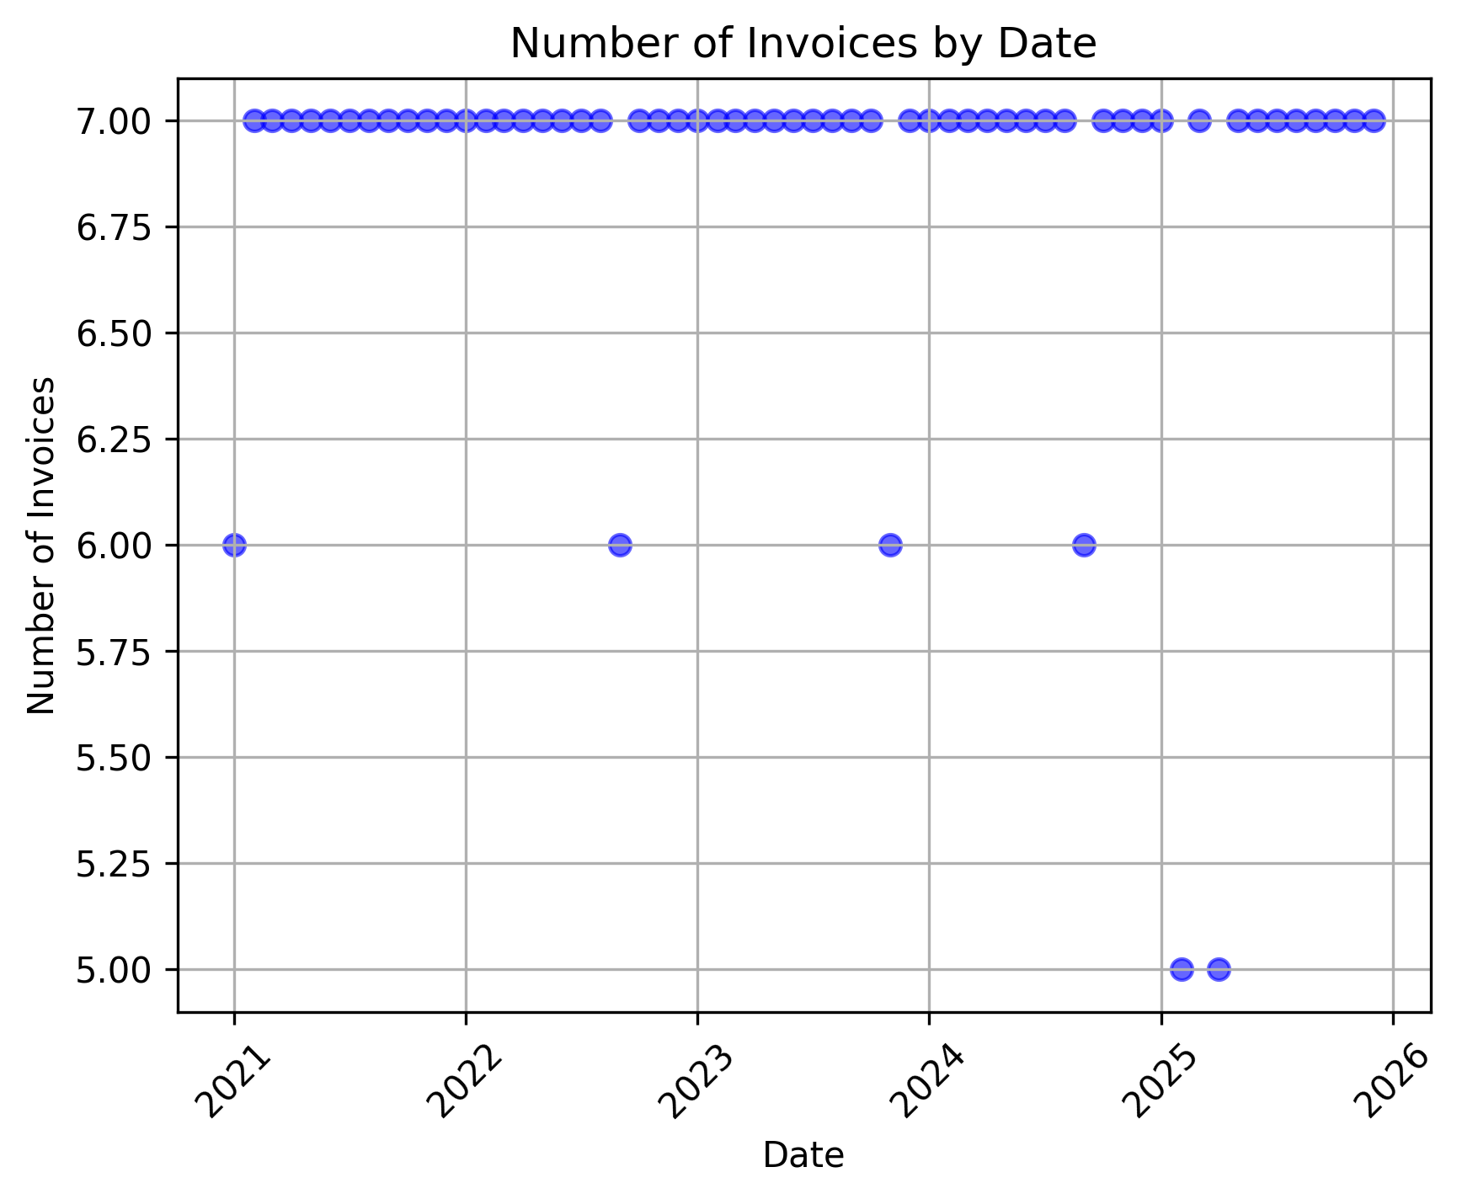
Scatter plot
Using a scatter plot, we can see if there is a relationship between the date and the number of invoices
The total number of invoices are 7 in most dates, except a little number of dates that has 6 invoices

Slide 15
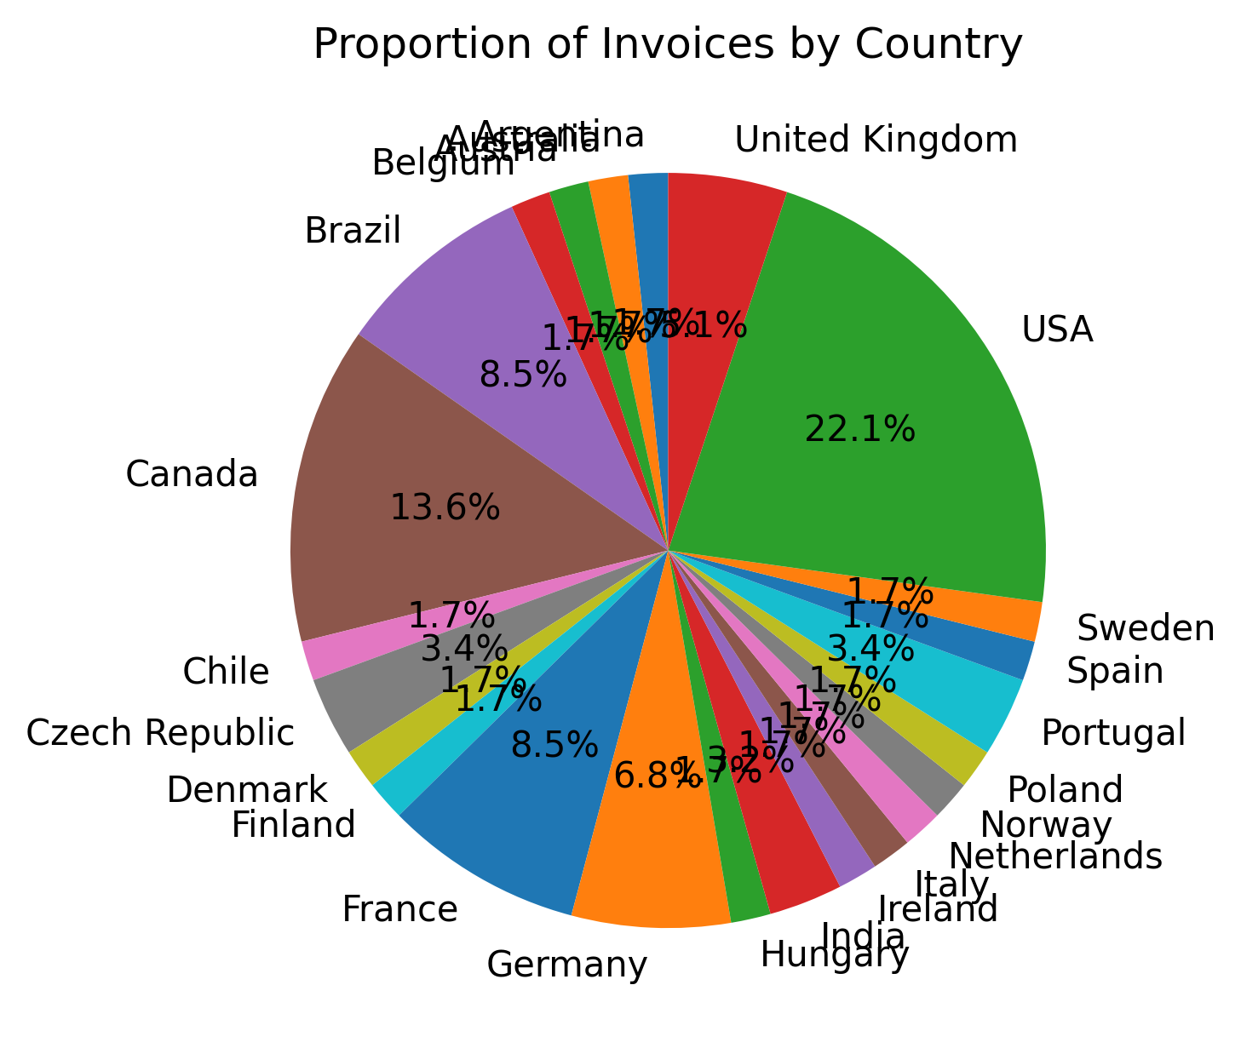
Proportion of invoices by country
The USA with more than 22% has the most number of invoices

Slide 16
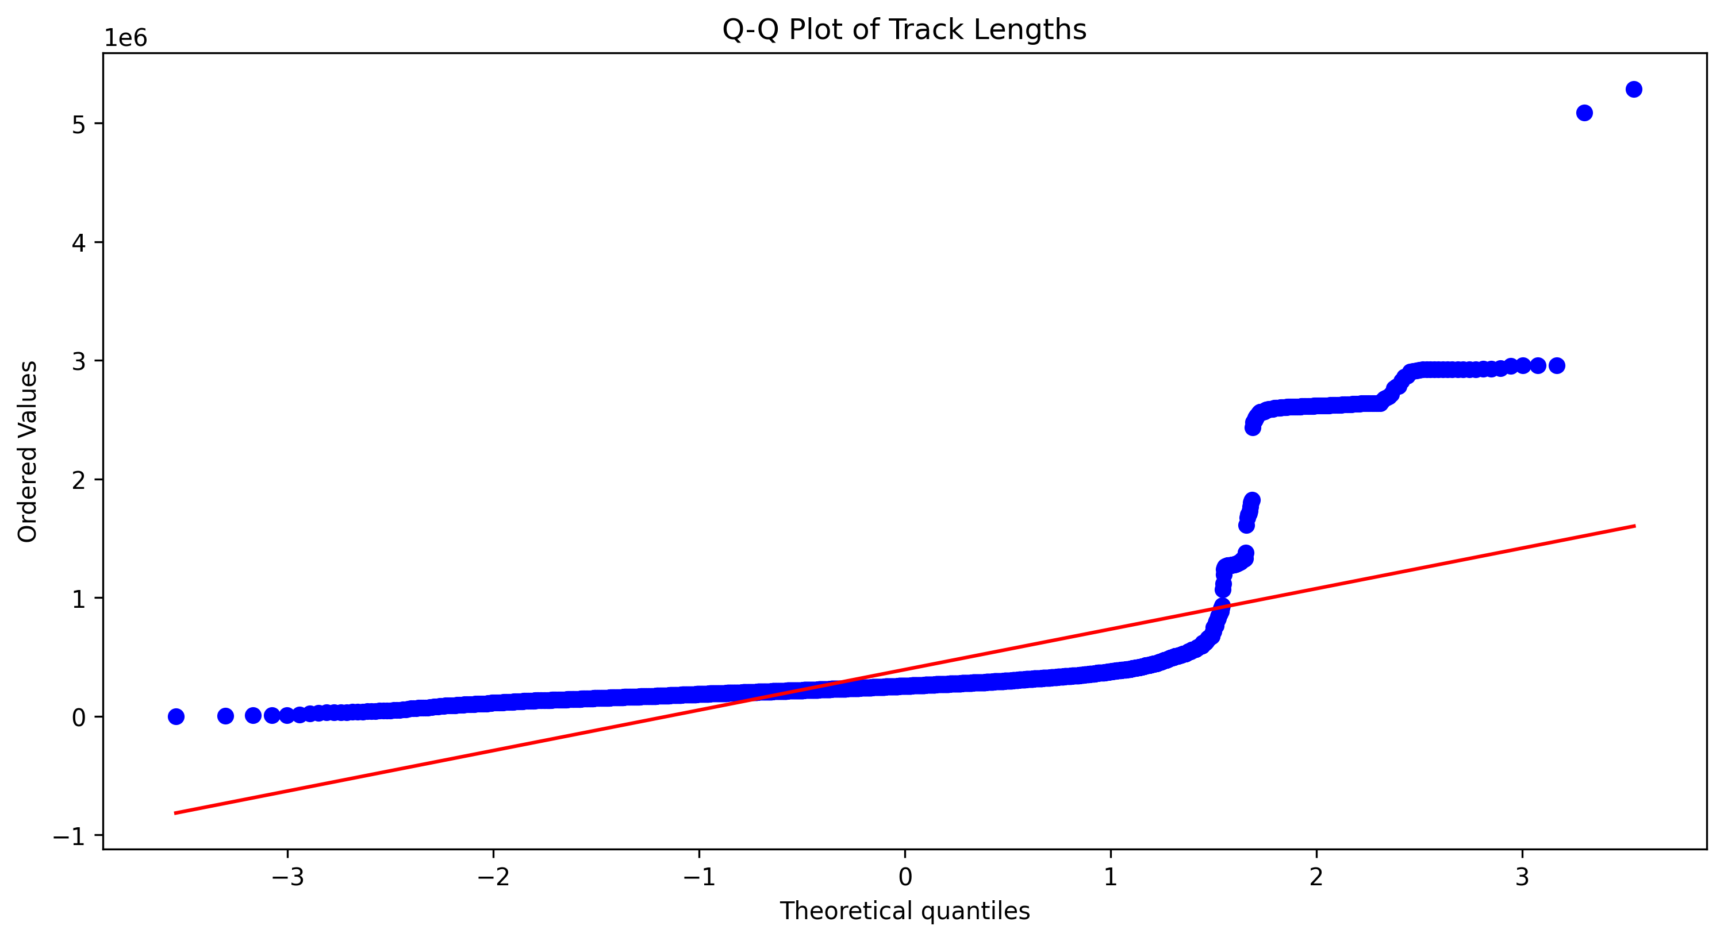
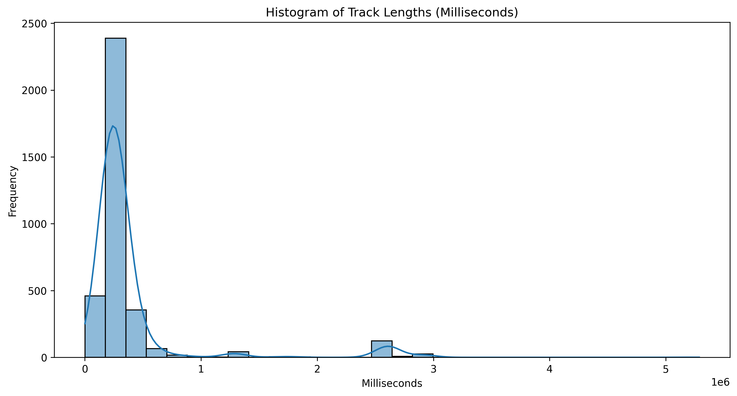
Normality test
The distribution of customers in countries
Based on Shapiro test, it’s not normal
The distribution of tracks per albums
Based on Kolmogorov-Smirnov Test it’s not normal
Histogram and QQ plot of Track Lengths (Milliseconds)

Slide 17
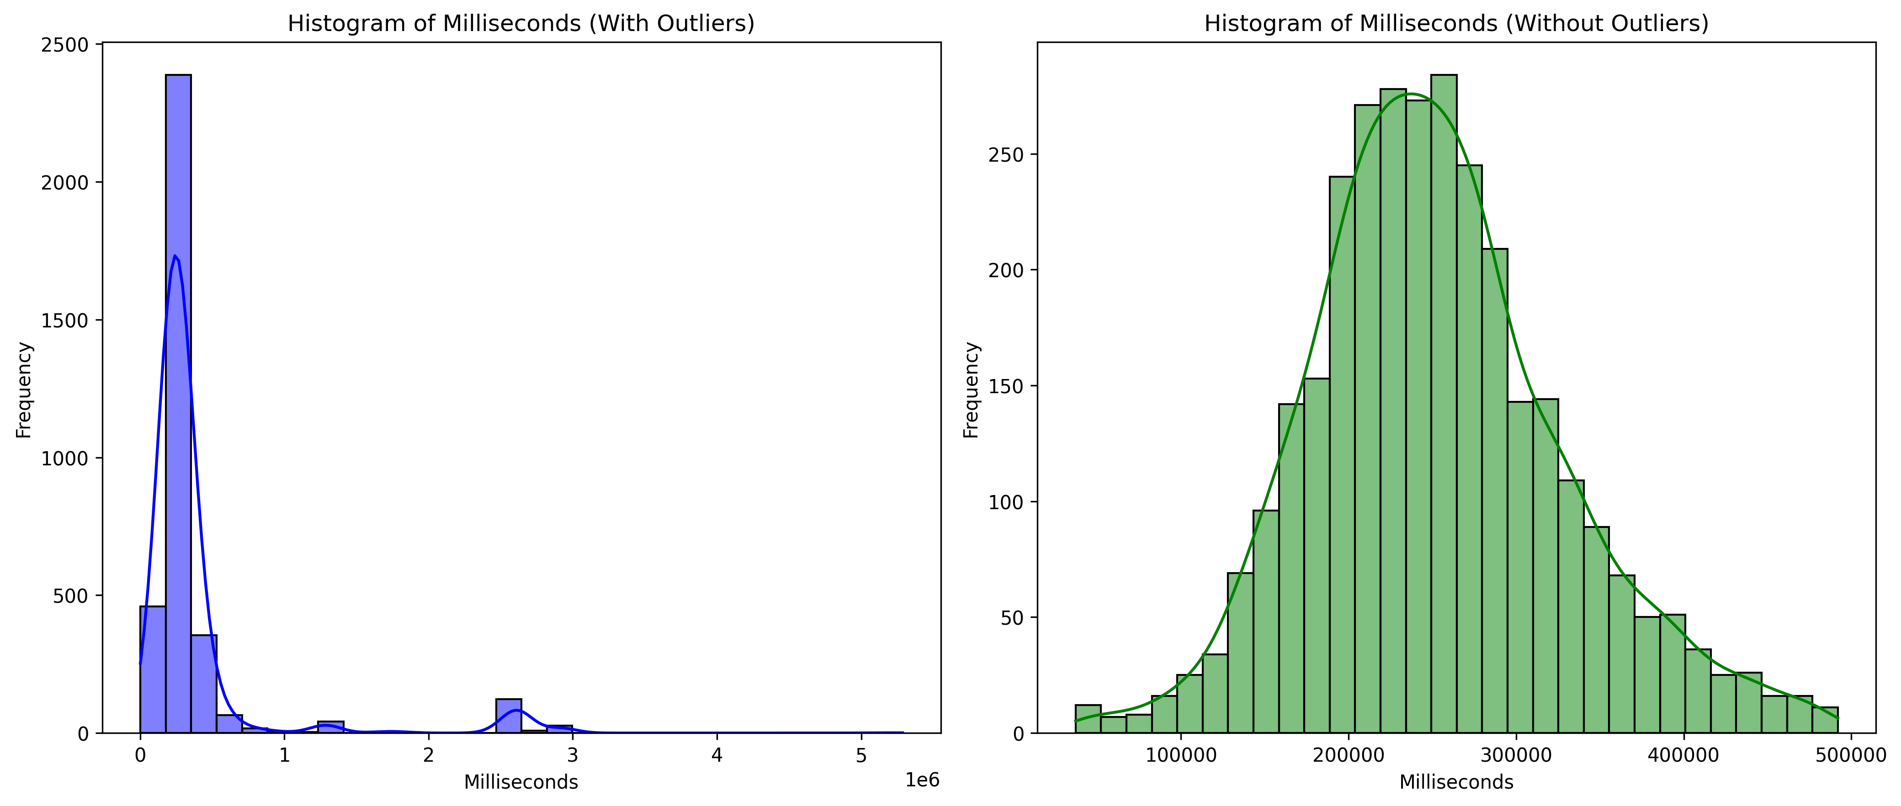
Remove outliers
Remove outliers from duration of tracks

Slide 18
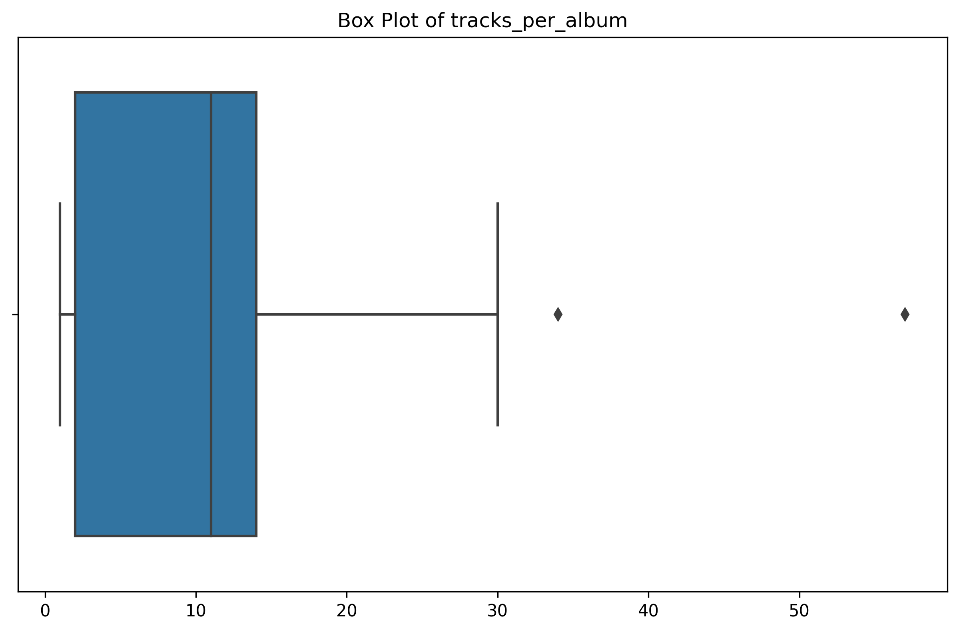
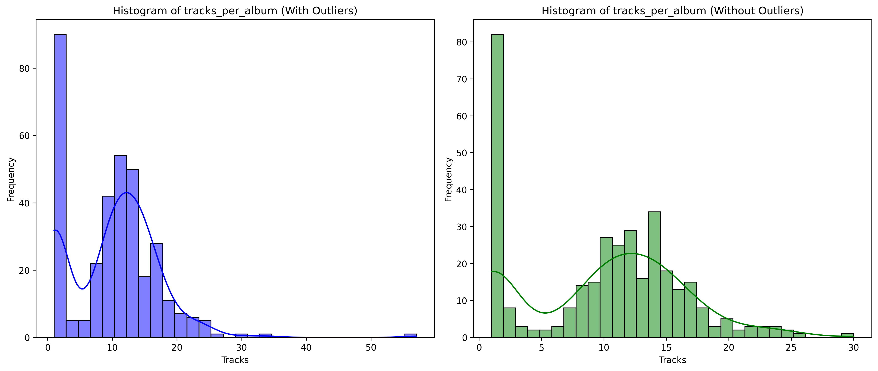
…Remove outliers
Box Plot of tracks per album

Slide 19
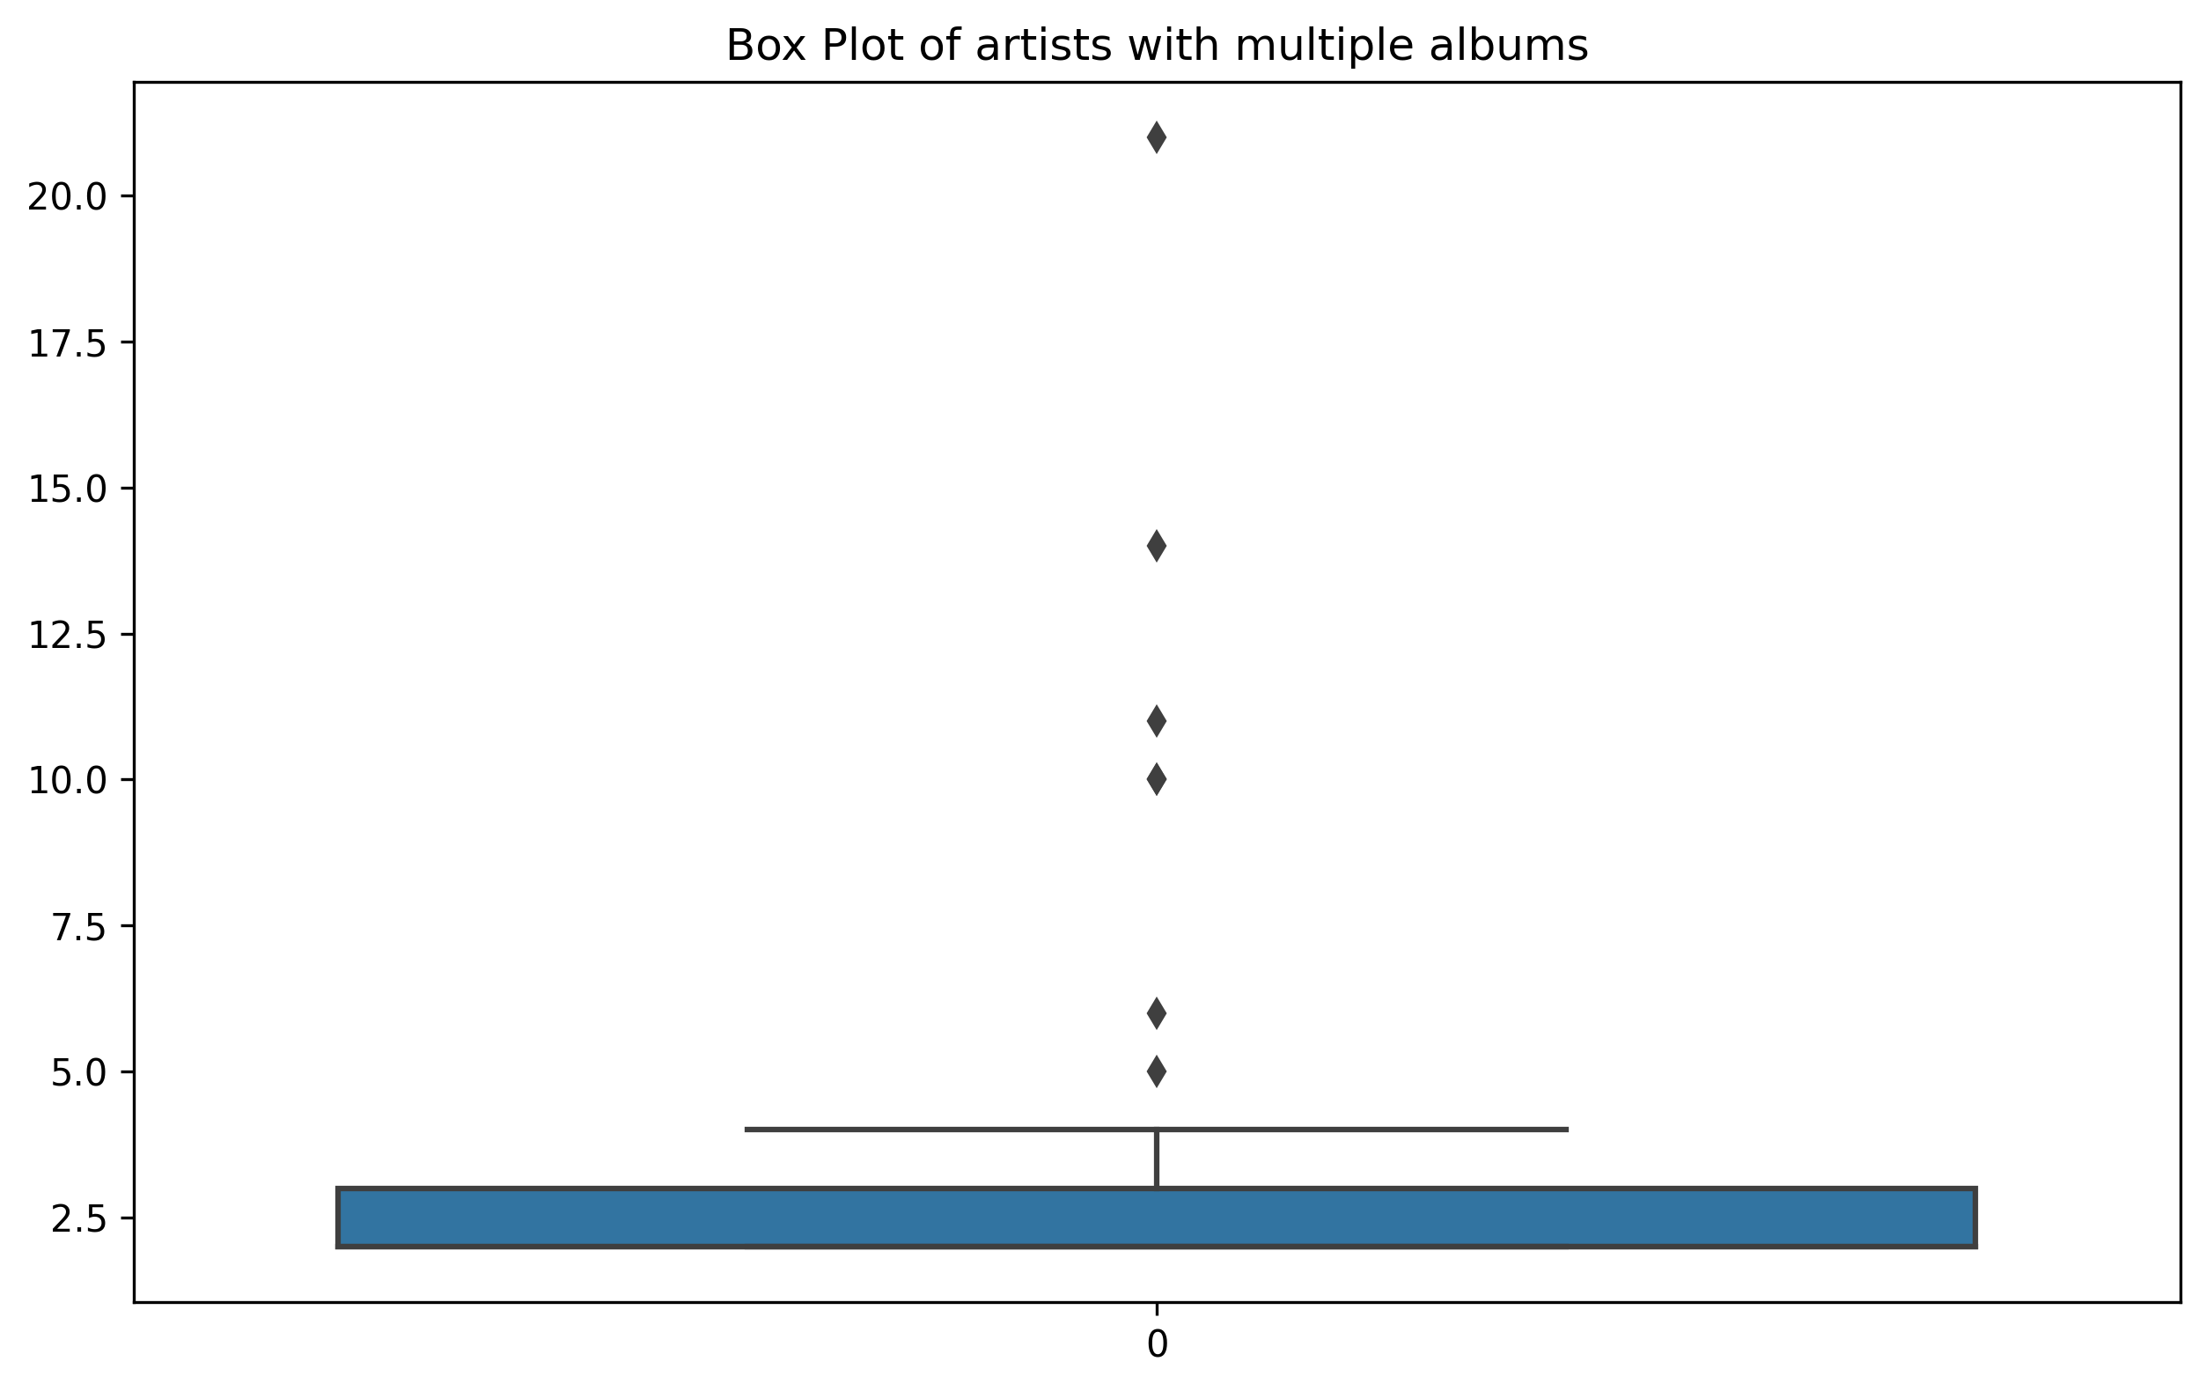
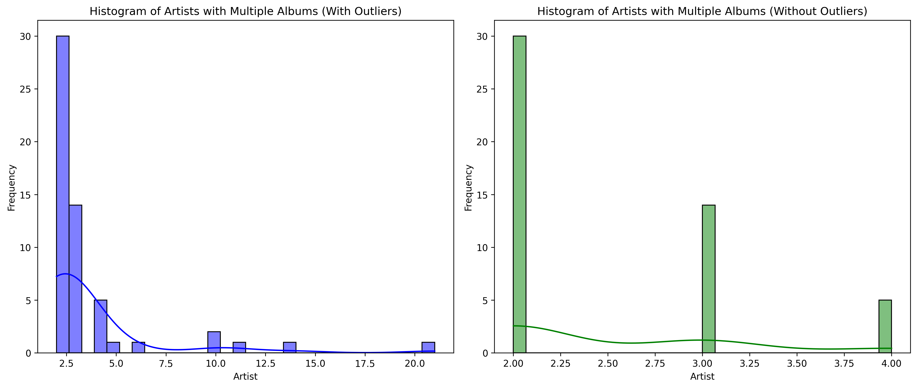
…Remove Outliers
Artists with multiple albums

Slide 21

Navigating Q&A sessions
Maintaining composure during the Q&A session is essential for projecting confidence and authority. Consider the following tips for staying composed:
Stay calm
Actively listen
Pause and reflect
Maintain eye contact
Know your material in advance
Anticipate common questions
Rehearse your responses

Slide 22

Speaking impact
Your ability to communicate effectively will leave a lasting impact on your audience
Effectively communicating involves not only delivering a message but also resonating with the experiences, values, and emotions of those listening

Slide 23
Dynamic delivery
Learn to infuse energy into your delivery to leave a lasting impression
One of the goals of effective communication is to motivate your audience
Metric | Measurement | Target | Actual
Audience attendance | # of attendees | 150 | 120
Engagement duration | Minutes | 60 | 75
Q&A interaction | # of questions | 10 | 15
Positive feedback | Percentage (%) | 90 | 95
Rate of information retention | Percentage (%) | 80 | 85

Slide 24
Final tips & takeaways
Consistent rehearsal
Strengthen your familiarity
Refine delivery style
Pacing, tone, and emphasis
Timing and transitions
Aim for seamless, professional delivery
Practice audience
Enlist colleagues to listen & provide feedback
Seek feedback
Reflect on performance
Explore new techniques
Set personal goals
Iterate and adapt

Slide 25
Speaking engagement metrics
Impact factor | Measurement | Target | Achieved
Audience interaction | Percentage (%) | 85 | 88
Knowledge retention | Percentage (%) | 75 | 80
Post-presentation surveys | Average rating | 4.2 | 4.5
Referral rate | Percentage (%) | 10 | 12
Collaboration opportunities | # of opportunities | 8 | 10

Slide 26
Thank you
Brita Tamm
502-555-0152
brita@firstupconsultants.com
www.firstupconsultants.com

